Slide 1






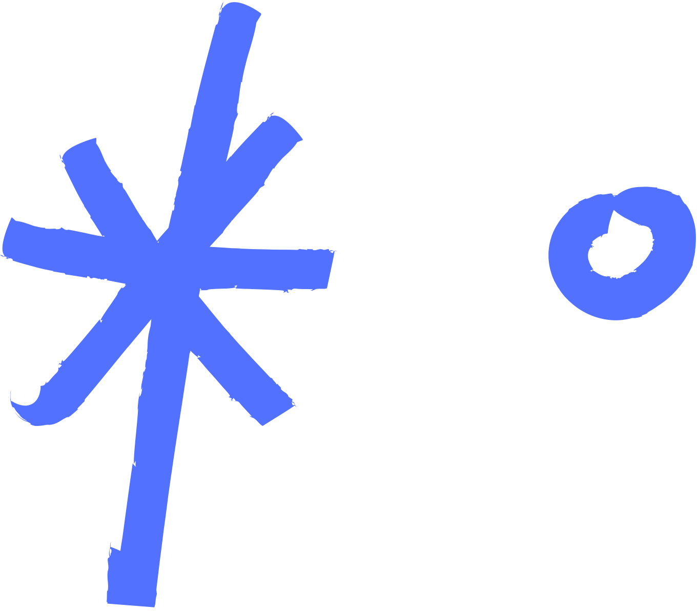


DROPOUT PROGRAMMER

Slide 2



WHAT IS NUMPY?
NumPy (Numerical Python) is a Python library used to work with numbers, arrays, and math functions. It helps us do fast mathematical operations on large datasets.
What is Library?
Video Link:
https://youtu.be/zcndSEyxveM?si=_bz4vK5GrtF_oBC9&t=90

Slide 3
WHAT IS LIBRARY?
A library is a collection of pre-written code (functions, classes, routines) designed to perform specific tasks or provide reusable functionalities. Libraries focus on providing tools that you can call upon to achieve certain goals within your program.
Library Types
Standard Library
External Libraries

Slide 4


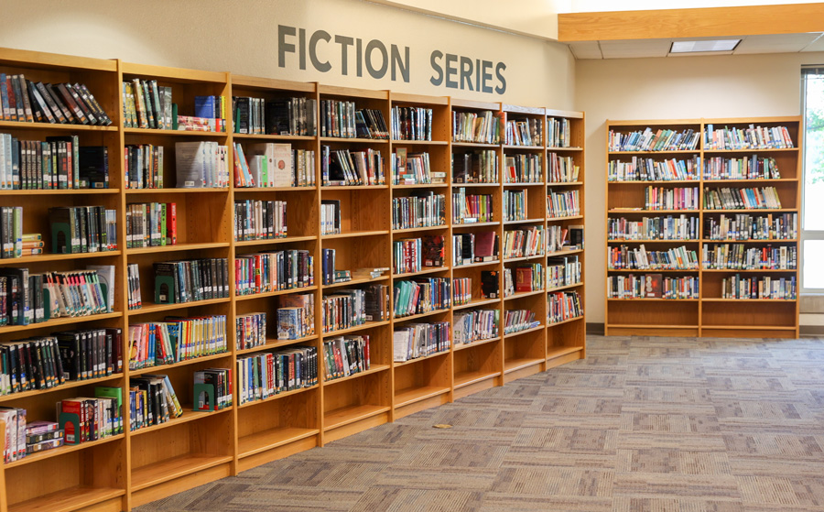
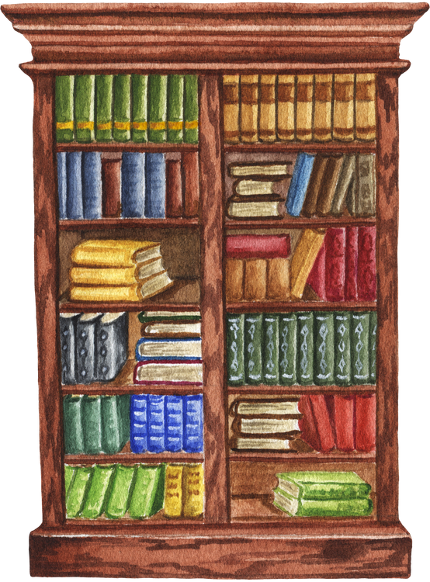

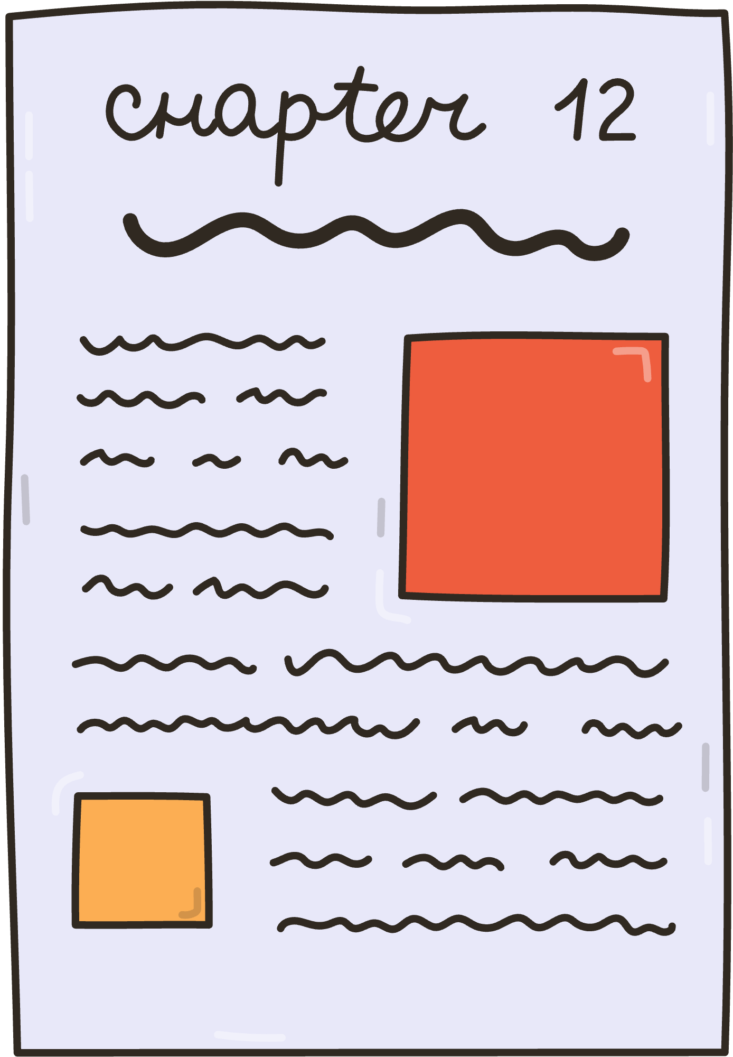
EXAMPLE
Method or function
Sub Package
Module
Class

Slide 5


HOW TO IMPORT
Import numpy as np
from sklearn.neighbors import KDTree
Import sklearn as sk
→ Working but Not a better way

Slide 6


Supervised Learning
WHY NUMPY?
NumPy is a Python library for fast math operations on arrays (lists of numbers). It is used in:
Data Science (for calculations)
Machine Learning (to work with numbers quickly)
Image Processing (images are just arrays of numbers)
Science & Engineering (simulations, math models)
Most Used NumPy Functions
1. Creating Arrays
2. Math Operations
3. Changing Arrays
np.array([1, 2, 3])
np.sum(arr)
np.mean(arr)
arr.reshape(2, 3)
np.concatenate([arr1, arr2])
np.zeros(3) → [0, 0, 0]
np.ones(3) → [1, 1, 1]
np.arange(5) → [0, 1, 2, 3, 4]

Slide 7
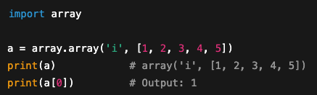
Supervised Learning
PYTHON STANDARD
Now the question is, are these functions not available in standard Python?
List
Array
a = [1, 2, 3, 4, 5]
b = [1, ‘D’, 3, “apple”, 5, 6.7]
The answer is no — some of these functions are available, while others are not. And even for
the ones that are available, they tend to be quite slow in standard Python, whereas in NumPy
they perform much faster.

Slide 8
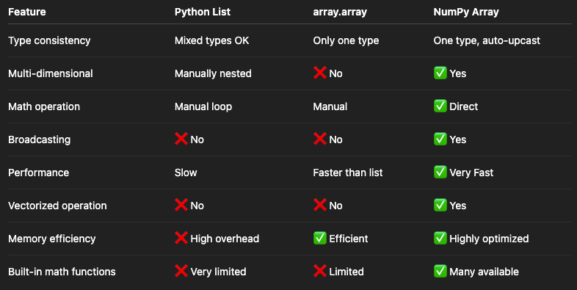

Supervised Learning
Example
WHY NUMPY?

Slide 9
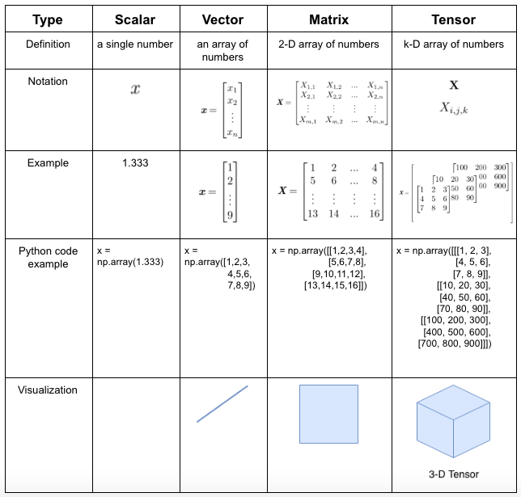
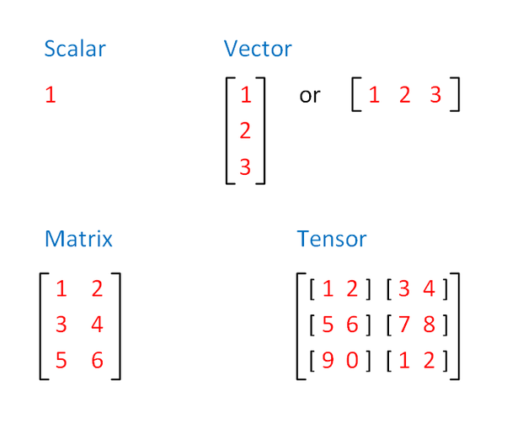
Supervised Learning
NUMPY ARRAY

Slide 10
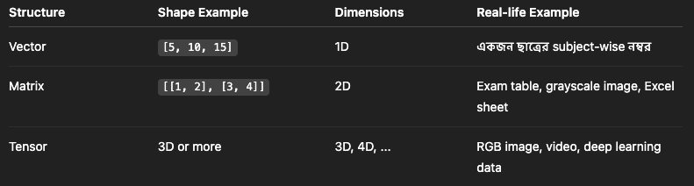
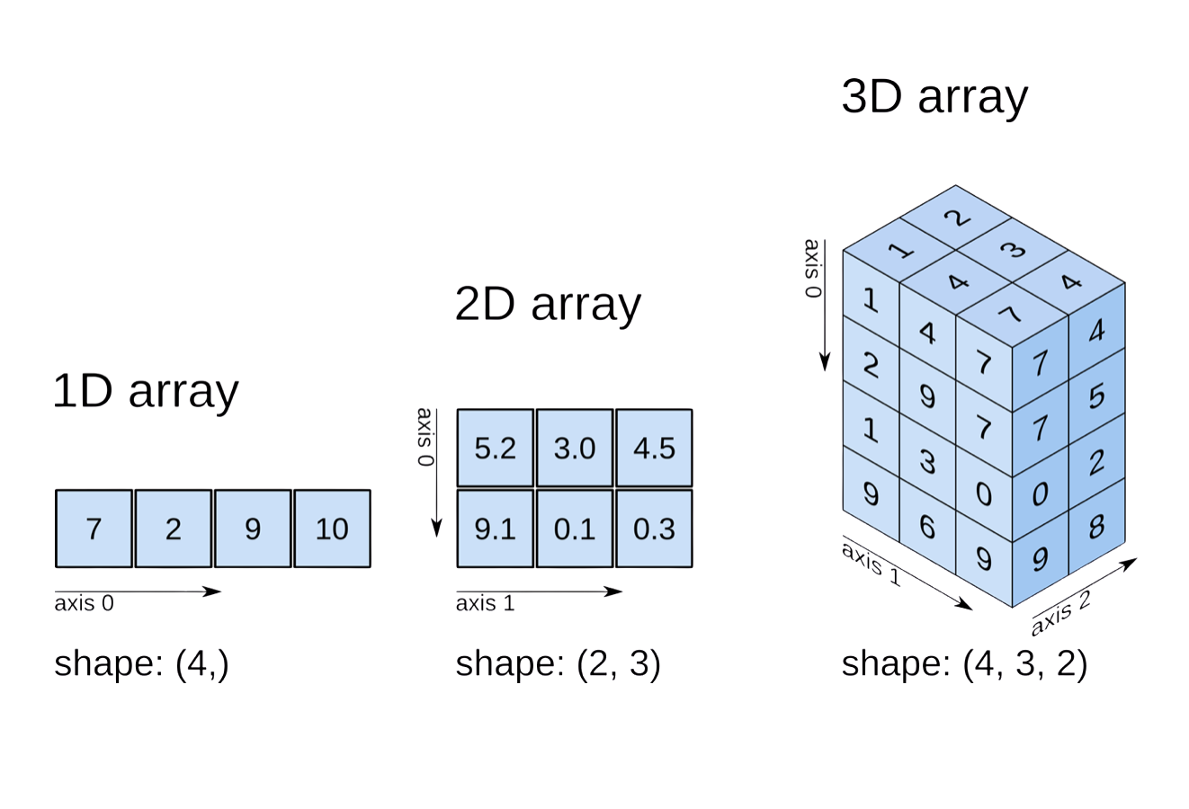
Supervised Learning
NUMPY ARRAY
Example
x = 5
Scalar
Vector
Matrix
Tensor

Slide 11
Supervised Learning
NUMPY’R চোদ্দ গুষ্টি
File Link

Slide 12





